Slide 1
Programming 101
File I/O

Slide 2
What is a File?
All files are collections of binary data
File extensions communicate possible ways the data is formatted
  Don’t actually change content
  A suggestion of how to parse
Most languages have built-in functions for file input/output (I/O)
Two primary methods of file formatting
  Text
  Byte Streams
I genuinely don’t know if there are others. If they exist, they don’t matter

Slide 3
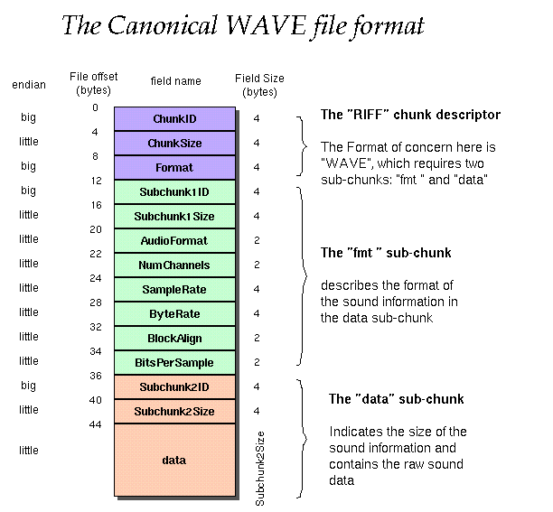
Byte Streams
e.g: .exe, .blend, .psd, .wav
Sequence of tightly packed headers and chunks
Headers say how many bytes of chunk data to read before the next header
Chunks contain all the important bits
This is how game assets get packaged into builds
I won’t make you work with these

Slide 4
Text Files
e.g: .txt, .py, .cpp (c++ code), .md (markdown)
Every 1-4 bytes (8-32 bits) is a character
The # of bytes per character is determined by the encoding
  The more bytes-per-character = more possible characters
  ASCII – 1 byte characters – Only English A-Z
    Small .txt files
    Characters like (é) (ô) (ñ) (ü) (漢字) appear as garbage (�)
  UTF-8 – 4 byte characters – Supports every writing system in the world
    Larger .txt files (but no one cares these days)

Slide 5
UTF-8 Encoding
Unicode Transformation Format – 8-bit
  Unicode – A text file standard for all the world’s languages
  Confusingly, characters are actually 8-32 bits long
Compatible with all languages, emojis, symbols, etc
  Binary strings that don’t make a known character produce a (�)
    Try dragging a .exe file into a text editor...
99% of all webpages use it, and you should too
When we open a text file, we should declare what encoding to use
  That encoding is used for reading and writing
  Always use UTF-8 unless you know to use something else

